Slide 1
DS Project on Accidents

Slide 2
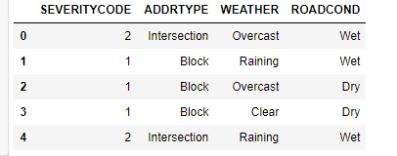
Data
SEVERITYCODE – Severity level: 0 = Low, 1 = High

Slide 3
Modelling
DECISION TREE CLASSIFICATION
Attributes used –
Address type - 'Intersection', 'Block', 'Alley'
Weather - 'Overcast', 'Raining', 'Clear', 'Unknown', 'Other', 'Snowing', 'Fog/Smog/Smoke', 'Sleet/Hail/Freezing Rain', 'Blowing Sand/Dirt', 'Severe Crosswind', 'Partly Cloudy'))
Road condition - 'Wet', 'Dry', 'Unknown', 'Snow/Slush', 'Ice', 'Other','Sand/Mud/Dirt', 'Standing Water', 'Oil'

Slide 4
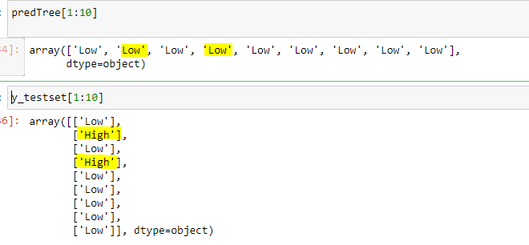
Evaluation
The accuracy of the model is fairly ok.

